Slide 1
Erasmus Mundus
Call for Proposals 2013
EACEA/38/2012

Slide 2
Erasmus Mundus - objectives
Enhance the quality of European HE through international co-operation
Improve the development of human resources
Promote dialogue and understanding between peoples and cultures
Promote Europe as a centre of excellence in learning around the world

Slide 3
Policy context → programme aims
Erasmus Mundus
Promote European higher education
Promote intercultural understanding
Improve career prospects
Bologna
process
EU 2020
EU external relations
3

Slide 4
Action 1
Joint Masters and Doctoral Programmes
implemented by EU and non-EU HEIs
full-study scholarships for students; grants for visiting scholars
Action 2
Partnerships
EU and non-EU HEIs
scholarships for short-term or degree-seeking student mobility at a range of levels, and for staff
Action 3
Promotional projects
raise profile of European higher education
tackle challenges of international higher education cooperation

Slide 5
What is a Call for Proposals?
Calls for Proposals and selections are managed by the Education, Audiovisual and Culture Executive Agency (EACEA) on behalf of the European Commission
2013 Call (EACEA/38/12) launched December 2012
Deadline for proposals: 15 April 2013
Assessment by independent experts
Targets:
- 62 Action 2 Partnerships
- 8 Action 3 Projects
Selection to be completed by July 2013
5

Slide 6
What’s new in 2013?
Earlier deadline: 15 April 2013
No Action 1 Call (Masters Courses and Joint Doctorates)
Action 2 Call:
    mobility for EU nationals to developing countries
- new country lots: Brazil, Tunisia, Uzbekistan
- increased budget
- eForm application
Action 3 Call:
- increased budget
- eForm application
Action 2 assessment: additional elements
Importance of geographical coverage :
EU and non—EU partners
Past/current performance of partnership: management capacity
6

Slide 7
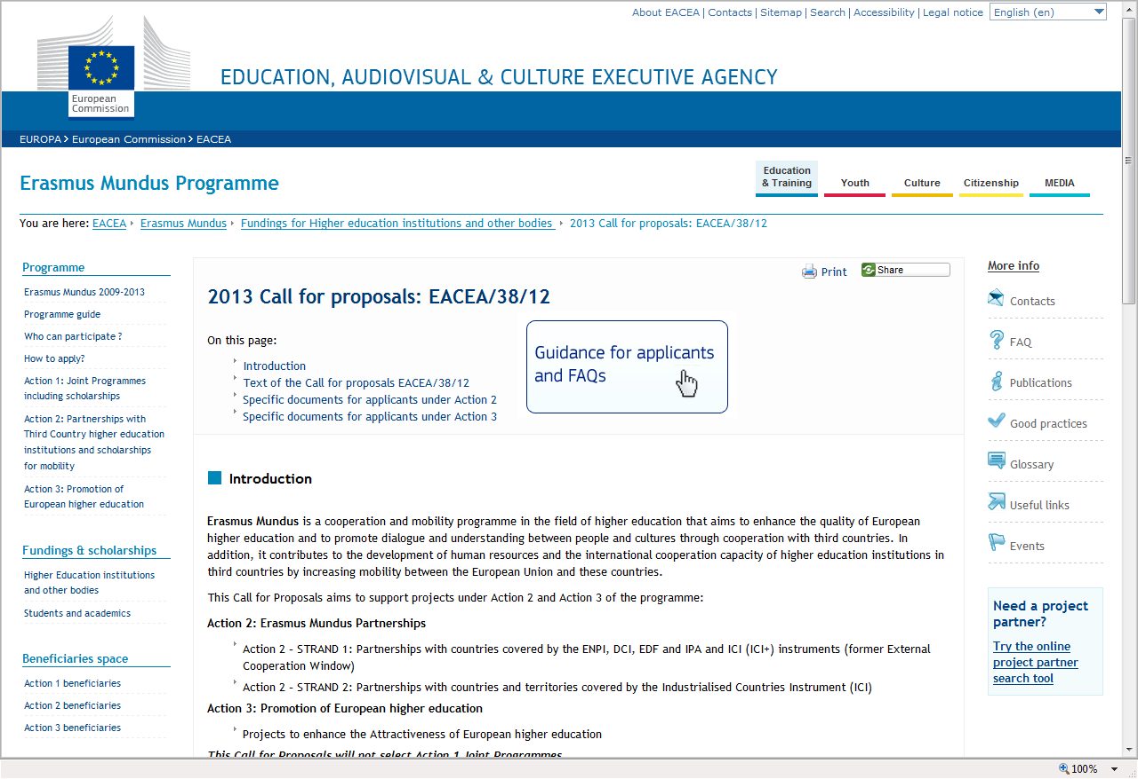
Check the Call documents & guidance
Check the official Call documents published on the Agency website before starting your application:
  http://eacea.ec.europa.eu/erasmus_mundus/funding/2013/call_eacea_38_12_en.php
Guidance for applicants

Slide 8

Key Documents for your application (1)
Programme Guide
Programme objectives, activities, eligibility criteria, conditions for support
For use with each Call for Proposals documents, Guidelines for Applicants (Action 2) and Application Forms and Instructions
  Latest version December 2012, valid for 2013 Call http://eacea.ec.europa.eu/erasmus_mundus/programme/programme_guide_en.php
Check what's new in the Programme Guide:
  http://eacea.ec.europa.eu/erasmus_mundus/programme/documents/2013/2013_whatsnew_pg_dec2012.pdf

Slide 9
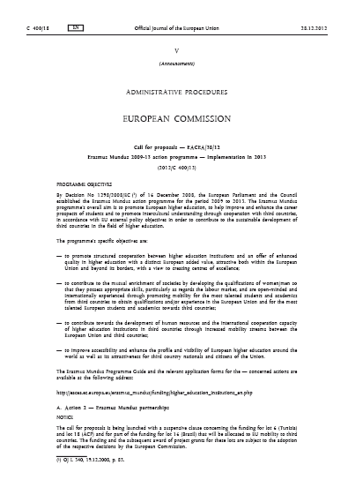
Key Documents for your application (2):
Call for Proposals in Official Journal
Brief Erasmus Mundus programme description
Budget and number of projects to be selected in 2013
Award criteria
Priorities under Action 3
Submission deadline

Slide 10

Key Documents for your application (3):
For Action 2 only: Specific guidelines
Lists geographical lots
Budget per lot →
minimum mobility flows
Thematic priorities (disciplines)
Specific criteria for partners/partnerships
Types of mobility funded and duration

Slide 11
Action 2 partnerships
Submitting an application
EACEA/38/2012

Slide 12
Action 2 Partnerships
Partnerships between HEIs from EU + non-EU HEIs from a specific region
Emphasise cooperation, transfer of know-how
Scholarships of varying lengths (3 months to 3 years) for academic disciplines offered by HEIs in the partnership
Bachelor, Masters, Doctorate, Post-Doctorate students + HEI staff (training, teaching, research)
2013 Call aims to select 62 partnerships

Slide 13
Common & specific elements in the lots
Common to all Action 2 lots
  A range of target groups for mobility
  A range of duration for mobility
  Up to 5 levels of higher education covered
  Project must start operations in year of selection (year ‘n’)
  Mobility may start in different ‘cohorts’ throughout partnership life
  Possible 'joint coordinator' role for one of the non-EU partners
Specific to individual lots (See Guidelines)
  Which target groups covered by mobility
  Which levels of higher education covered
  Thematic fields of study
  Partnership composition

Slide 14
2013 Call – Action 2 targets
Action 2: Strand 1 (countries covered by ENPI, DCI & ICI+, EDF, IPA)
  18 lots for 57 partnerships
  Total budget EUR 187.4 million
  Mobility for minimum 6,877 individuals

Slide 15
2013 Call – Action 2 targets
Action 2: Strand 2 (countries covered by ICI)
  4 lots for 5 partnerships
  Total budget EUR 6.75 million
  Mobility for minimum 142 individuals

Slide 16
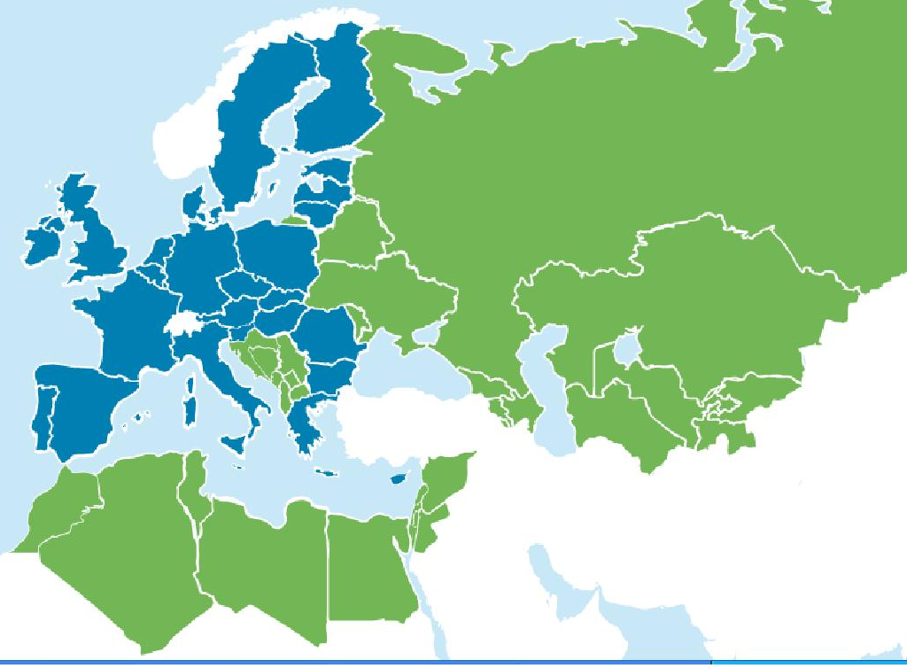
Proposed shape of lots:
Action 2 Call 2013 (neighbouring countries)
Proposed n° of partnerships:
x
Lot 4
Russia
2
3
4
Lot 7
Albania, Bosnia & Herzegovina
FYROM, Kosovo*, Montenegro, Serbia
Lot 5
Belarus, Moldova, Ukraine, Armenia, Azerbaijan, Georgia
Lot 9
Kazakhstan, Kyrgyzstan, Tajikistan, Turkmenistan, Uzbekistan
9
NEW!
Lot 10
Uzbekistan country lot
2
NEW!
Lot 6
Tunisia
country lot
1
1
Lot 2
Jordan, Lebanon,
OPT, Syria
Lot 3
Israel
4
Lot 1
Morocco, Algeria, Tunisia, Libya, Egypt
4
*This designation is without prejudice to positions on status, and
is in line with UNSCR 1244 and the ICJ Opinion on the Kosovo Declaration of Independence

Slide 17

Proposed shape of lots:
Action 2 Call 2013 (rest of the world)
Proposed n° of partnerships:
x
2
Lot 1
North America
1
4
Lot 8
Iran Iraq Yemen
1
Lot 3
Japan
Korea
Lot 11
Asia West
Lot 4
Gulf countries
1
4
Lot 13
India
Lot 12
Asia East
Lot 15
Latin America
(C)
3
4
Lot 18
ACP countries
2
3
NEW!
Lot 16
Brazil
Lot 14
Latin America
(S)
3
3
Lot 17
South Africa
1
Lot 4
Australia
New Zealand
Strand 1
Strand 2

Slide 18
Action 2 Award Criteria: Strand 1
1. Relevance (25%)
2. Quality (65% total)
  2.1. Partnership composition and cooperation mechanisms (20%)
  2.2. Organisation and implementation of mobility (25%)
  2.3. Student/staff facilities and follow-up (20%)
3. Sustainability (10%)

Slide 19
Action 2 Award Criteria: Strand 2
1.Relevance (25%)
2. Contribution to excellence (25%)
3. Quality (50% total)
  3.1. Partnership composition and cooperation mechanisms (15%)
  3.2. Organisation and implementation of mobility (20%)
  3.3. Student/staff facilities and follow-up (15%)

Slide 20
Action 2
Use of the eForm
  Applications to be submitted using an eForm
  Static version of eForm available second half of January
    Shows structure and required content of eForm
    Provides all annexes required to be uploaded within the eForm
  Final version of eForm available 1 March 2013

Slide 21
Action 2
Main elements of your application (1)
  Identification of applicant and other organisations
  Description of the project
  Technical capacity of applicant consortium
  Declaration on Honour

Slide 22
Action 2
Main elements of your application (2)
  Budget
  Partnership statement signed by all partners
  Project summary sheet for publication on EACEA website
  Bank account form
  Legal entity form

Slide 23
Action 2: Submit your application
  The eForm application will be considered as the original version.
  1 paper copy identical to the eForm application must be posted to the Agency by the deadline indicated at the following address:
  Education, Audiovisual and Culture Executive Agency
  Call for proposals EACEA/38/12 – Action 2
  BOUR 02/029
  Avenue du Bourget, 1
  BE-1140 Bruxelles

Slide 24
Action 3 promotion projects
Submitting an application
EACEA/38/2012

Slide 25
Action 3: Promotion of European Higher Education
Action 3 provides support to transnational initiatives, studies, projects, events and other activities aimed at enhancing the attractiveness, profile, image and visibility of, and accessibility to, European higher education in the world.

Slide 26
2013 Call – Action 3 targets
Budget: EUR 2 million
Target: 8 projects
Indicative project size: from EUR 100,000 to 350,000
European co-financing to max 75%
Project duration: 12 – 36 months
Min. 3 European and 1 third-country partner

Slide 27
2013 Call – Action 3 priorities
  Action 3 priority areas – projects aiming at:
  Promotion of European higher education in certain geographical areas (Eastern and Southern neighbourhood countries)
  Improving services for international students
  Addressing the international dimension of Quality Assurance
  Promoting the joint programmes towards students
  Promoting the joint programmes towards employers
  Creating better synergies between the EU policy dialogue with third countries and the cooperation projects supported by the European programmes in higher education.
27
Notes:
27

Slide 28
Action 3 project requirements
  Clear European dimension and wide geographical scope
  Clear international (third-country) dimension
  Must contribute to fostering intercultural dialogue and mutual understanding between cultures
  Ensure no overlap with other EU programmes for higher education

Slide 29
Action 3 Award Criteria
  Relevance to Erasmus Mundus Programme (25%)
  Expected impact to enhance attractiveness of European higher education worldwide (25%)
  Dissemination of results and experiences, quality assurance, sustainability and exploitation of results (15%)
  Consortium composition and cooperation mechanisms (15%)
  Work plan and budget (20%)

Slide 30
Action 3: Use of the eForm
  Applications to be submitted using an eForm
  Static version of eForm available second half of January
    Shows structure and required content of eForm
    Provides all annexes required to be uploaded within the eForm
  Final version of eForm available 1 March 2013

Slide 31
Action 3:
Main elements of your application (1)
  Identification of applicant and partners
  Organisation and activities
  Project identification
    Project title
    Priority area covered
    Duration
    Summary description of the project
    Detailed project description (award criteria responses)
  Budget

Slide 32
Action 3:
Main elements of your application (2)
  Work Plan
  CVs of persons responsible in each partner
  Letters of endorsement, Declarations on Honour from partner organisations)
  Legal status documentation
  Financial identification
  Privacy statement and information
  Checklist
  Declaration on Honour by the legal representative of the applicant organisation
  Model Declaration on Honour by partner organisation
  Detailed Budget

Slide 33
Action 3:
Main elements of your application budget
  Indication of total budget and EU grant requested (max 75% of total budget)
  Composition of the partnership contribution
  Staff costs
  Travel and subsistence
  Equipment
  Subcontracting
  Conferences-Seminars:
    Organisation costs
    Travel and subsistence costs of participants and speakers
    Interpreters
    Speaker fees
  Other direct costs
  Indirect costs (max 7% of direct costs)
  New: light audit report - costs eligible

Slide 34
Action 3: Submit your application
  The eForm application will be considered as the original version.
  1 paper copy identical to the eForm application must be posted to the Agency by the deadline indicated at the following address:
  Education, Audiovisual and Culture Executive Agency
  Call for proposals EACEA/38/12 – Action 3
  BOUR 02/029
  Avenue du Bourget, 1
  BE-1140 Bruxelles

Slide 35
Erasmus Mundus selection process
Action 2
Action 3
EACEA: Eligibility and selection criteria
EU Delegations:
Eligibility non-EU HEIs
Relevance regional priorities
External experts: Assessment of proposals
Evaluation Committee
Selection Decision
Evaluation Committee
Selection Decision

Slide 36

More information http://eacea.ec.europa.eu/erasmus_mundus/index_en.php
Programme Guide
Calls for Proposals
FAQs
Good practice
Selected projects
Partner search
Beneficiaries’ space
36
http://eacea.ec.europa.eu/erasmus_mundus/index_en.php

Slide 37
Questions on the Call?
Erasmus Mundus mailbox:
EACEA-Erasmus-Mundus@ec.europa.eu

Slide 38
The future
Erasmus Mundus 2009-2013
Erasmus for All 2014-2020
Programme for education, youth, culture and sport
Rationale: streamline EU support in all areas
Strong international component

Slide 39
Erasmus for All: international HE cooperation
  The new programme will maintain support for:
  Mobility for students and staff from non-EU countries
  Joint masters degrees with scholarships
  Programmes for intra-university cooperation on capacity-building
  Policy dialogue on higher education between EU and rest of the world

